Slide 1
CSC402:PROGRAMMING I
CHAPTER 2: ALGORITHMIC PROBLEM SOLVING
SEQUENCE STATEMENT

Slide 2
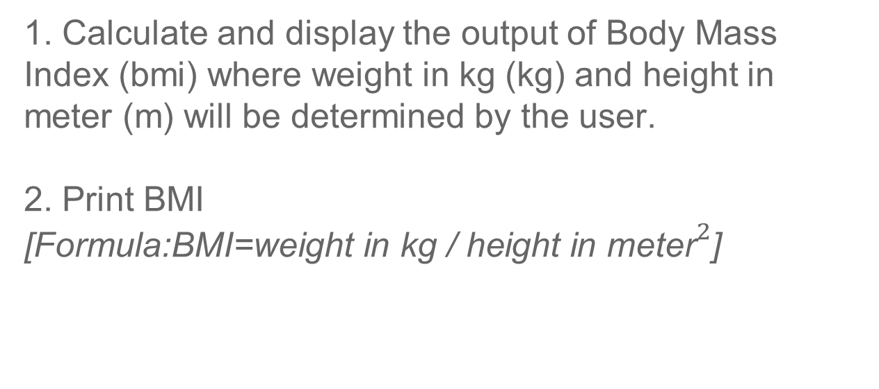
Example 1: Body Mass Index
1. Calculate and display the output of Body Mass Index (bmi) where weight in kg (kg) and height in meter (m) will be determined by the user.
2. Print BMI [${\text{Formula}\text{:}\text{BMI}\text{=}\text{weight} \text{in} \text{kg}\text{ / }\text{height} \text{in} \text{meter}}^{2}$]

Slide 3

Problem Identification
GOAL : To calculate and display Body Mass Index (BMI)
INPUT :
Weight (kg)
Height (m)
PROCESS:
BMI = weight / ${\text{height}}^{2}$
OUTPUT:
The value of BMI
Weight and height MUST be in positive number

Slide 4
Pseudocode
Start
Input:
Get weight (kg)
Get height (m)
Process:
Calculate Body Mass Index (BMI)
BMI = weight / height * height
Output:
Print BMI
End

Slide 5
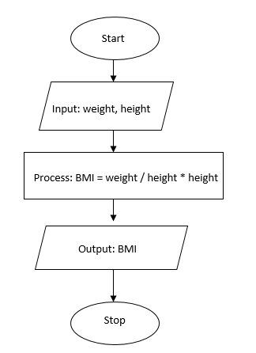
Flowchart

Slide 6
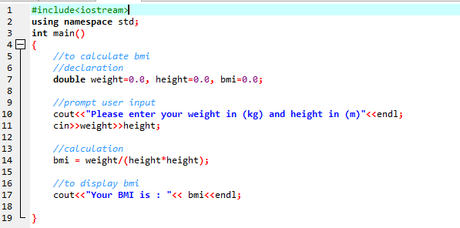
C++ Program

Slide 7
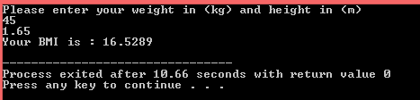
Output

Slide 8
Example 2: Calculate Salary
An employee of a parking garage is paid by the number of hours that he or she work per day. The employee will be paid for RM 9.50 per hour. Receives hours work as the input and calculate the total salary that will be paid.

Slide 9
Problem Identification
GOAL : To calculate the total salary.
INPUT :
hours work
PROCESS:
total salary = hours work * 9.50
OUTPUT:
The total salary

Slide 10
Pseudocode
Start
Input:
Get hours work
Process:
Calculate Total Salary
total salary = hours work * 9.50
Output:
Print total salary
End

Slide 11
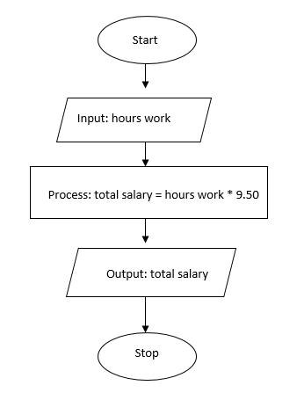
Flowchart

Slide 12
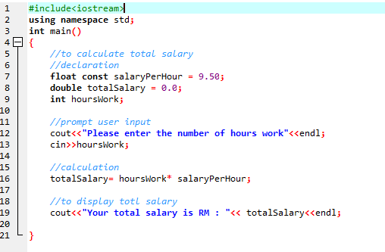
C++ Program

Slide 13
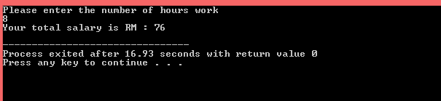
Output

Slide 14
EXERCISES
Sequence Structure
Develop a pseudocode and write a C++ program that converts the distance in mile to kilometer. Hint: 1 km = 1.609m
2. Develop a pseudocode and write a C++ program that reads the radius of a circle, and computes the area of the circle. Trace the content of the variables and determine the output of the pseudocode if the input for radius is:
a. 3
b. 10
c. 150

Slide 15
EXERCISES
3. Calculate the average weight of four students. Attempt to analyze this problem by stating it’s input, output and the formula required to determine the average weight. Write a C++ program to display each student’s weight and the average weight calculated.
4. Develop a pseudocode and write a C++ program to convert the time entered by the user in the form of day, hours and minute to minutes. The conversion unit is as follows:
1 day is equivalent to 24 hours
1 hour is equivalent to 60 minutes
5 Draw a flowchart and write a C++ program to convert the temperature entered by user in unit of Fahrenheit to unit of Celcius. The conversion formula is as follows:
Fahrenheit = Celsius * 9/5 + 32

Slide 16
ANSWER
Develop a pseudocode and write a C++ program that converts the distance in mile to kilometer. Hint: 1 km = 1.609m
Start
Input:
distanceInMile
Process:
km = distanceInMile * mile
Output:
km
End

Slide 17
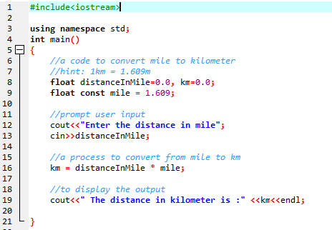
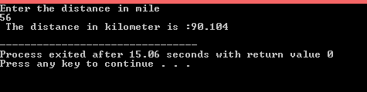
ANSWER

Slide 18
ANSWER
2. Develop a pseudocode and write a C++ program that reads the radius of a circle, and computes the area of the circle. Trace the content of the variables and determine the output of the pseudocode if the input for radius is:
a. 3
b. 10
c. 150
Start
Input:
radius
Process:
areaOfCircle = PI * radius* radius
Output:
areaOfCircle
End

Slide 19
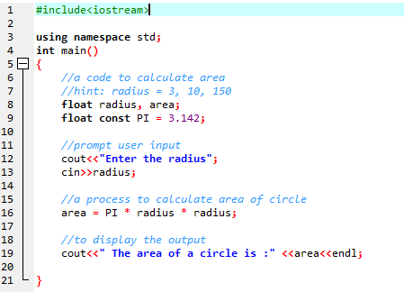



ANSWER

Slide 20
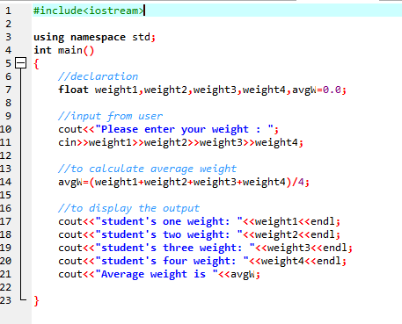
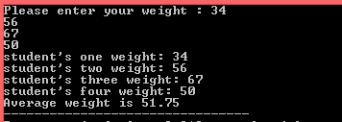
ANSWER
3. Calculate the average weight of four students. Attempt to analyze this problem by stating it’s input, output and the formula required to determine the average weight. Write a C++ program to display each student’s weight and the average weight calculated.

Slide 21
ANSWER
4. Develop a pseudocode and write a C++ program to convert the time entered by the user in the form of day, hours and minute to minutes. The conversion unit is as follows:
1 day is equivalent to 24 hours
1 hour is equivalent to 60 minutes
Start
Input:
days, hours,minutes
Process:
timeInMinutes = (days *1440) + (hours * 60) + minutes
Output:
timeInMinutes
End

Slide 22
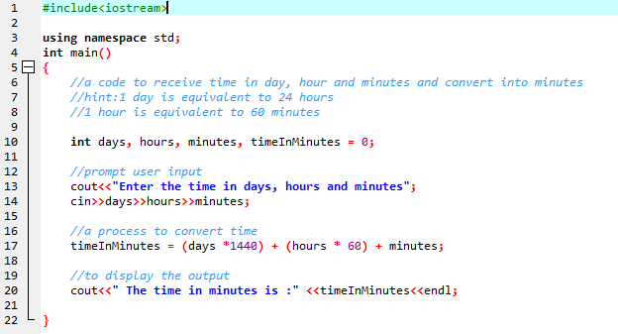

ANSWER
4. Develop a pseudocode and write a C++ program to convert the time entered by the user in the form of day, hours and minute to minutes. The conversion unit is as follows:
1 day is equivalent to 24 hours
1 hour is equivalent to 60 minutes

Slide 23
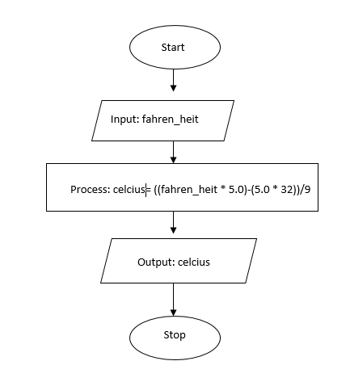
ANSWER
5 Draw a flowchart and write a C++ program to convert the temperature entered by user in unit of Fahrenheit to unit of Celcius. The conversion formula is as follows:
Fahrenheit = Celsius * 9/5 + 32

Slide 24
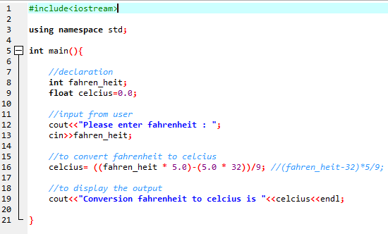

ANSWER
5 Draw a flowchart and write a C++ program to convert the temperature entered by user in unit of Fahrenheit to unit of Celcius. The conversion formula is as follows:
Fahrenheit = Celsius * 9/5 + 32

Slide 25
THANK YOU
Any questions?

